Slide 1
Mapping and PCI
What you wanted the most but you were afraid to ask :
Mapping your PCI in linux

Slide 2
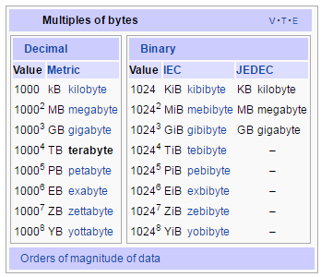
Back to School
2¹⁰ = 1024 = 1K
2²⁰ = 1024*1024 = 1M
2³⁰ = 1024*1024*1024 = 1G
2⁴⁰ = 1024*1024*1024*1024 = 1T
2⁸ = ??
2¹⁶ = ??
2³² = ??

Slide 3
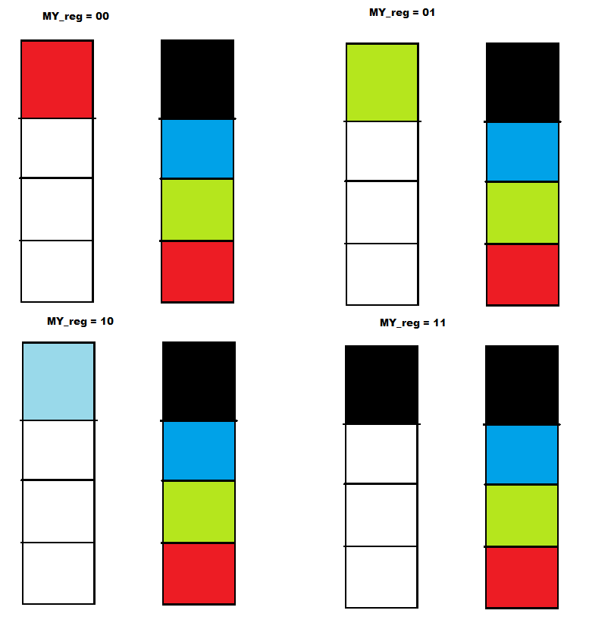
Simple Mapping

Slide 4
Intel
“THE” Manuals
http://www.intel.com/content/www/us/en/processors/architectures-software-developer-manuals.html
The sad story
https://en.wikipedia.org/wiki/IA-64
https://en.wikipedia.org/wiki/IA-32
https://en.wikipedia.org/wiki/X86-64

Slide 5
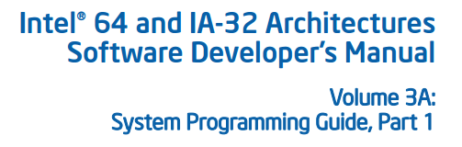
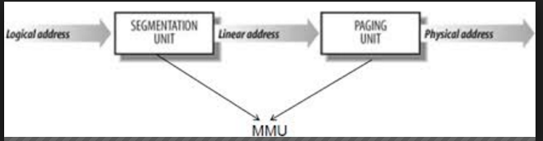
MMU:Segmentation and Paging

Slide 6
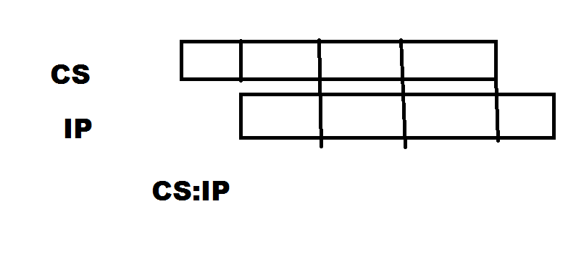
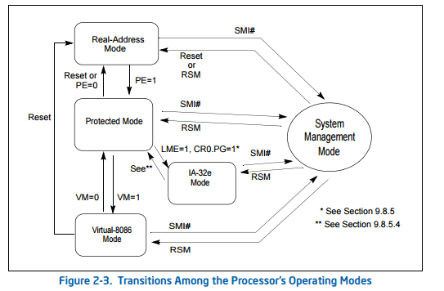
Processor modes
Real Mode
And the Flat mode?
https://en.wikipedia.org/wiki/Flat_memory_model

Slide 7
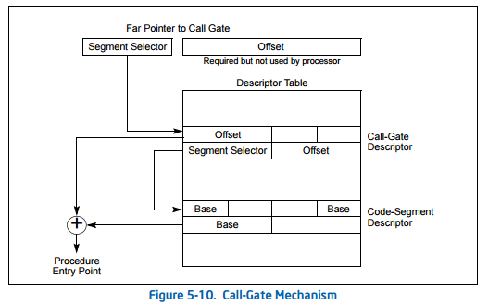
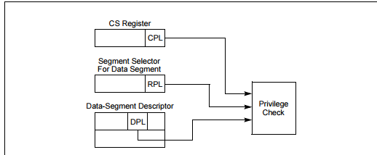
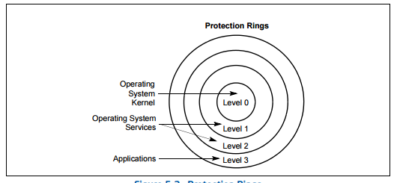
Segmentation

Slide 8
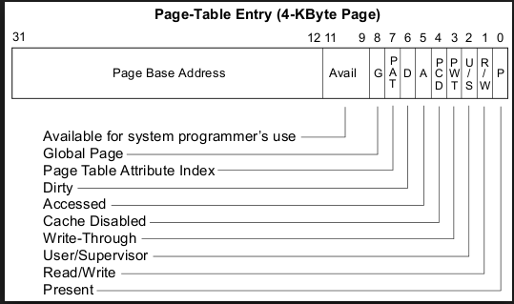
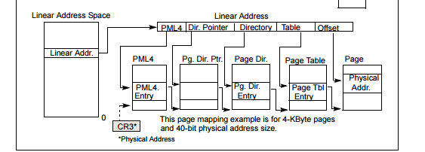
Paging
NOTICE: Single bit in User/Supervisor

Slide 9
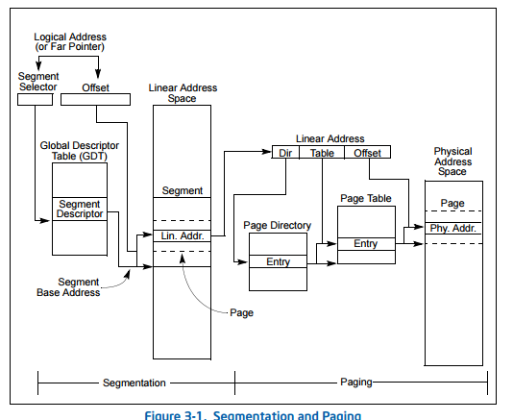
Segmentation and Paging

Slide 10
Must Read
How x86 boots
http://www.drdobbs.com/parallel/booting-an-intel-architecture-system-par/232300699
Duarte
http://duartes.org/gustavo/blog/archives/
Florent Bruneau
https://techtalk.intersec.com/2013/07/memory-part-1-memory-types/

Slide 11
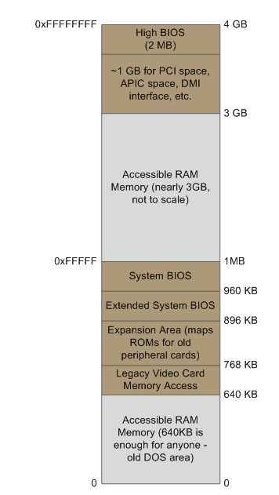
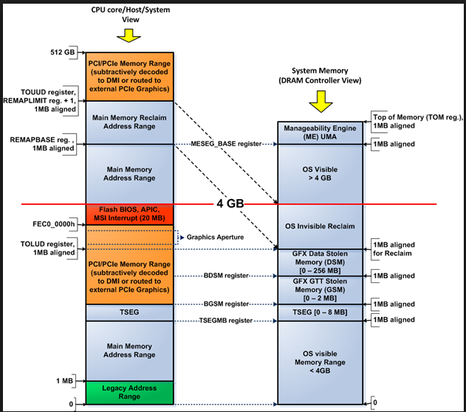
Physical Memory
http://www.intel.com/content/dam/www/public/us/en/documents/datasheets/mobile-5th-gen-core-family-datasheet-vol-2.pdf
E820
https://en.wikipedia.org/wiki/E820

Slide 12
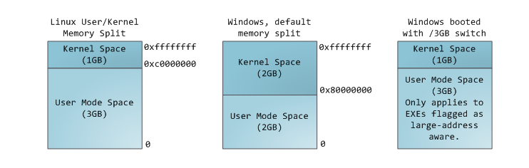
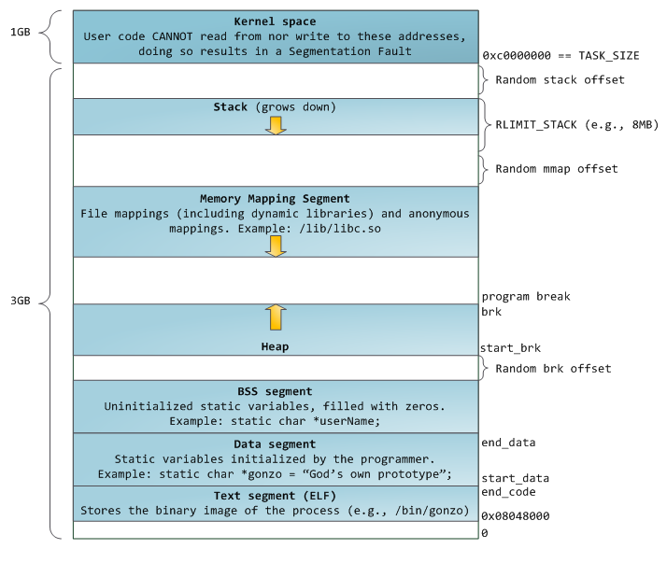
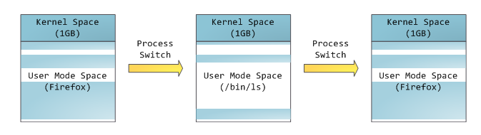
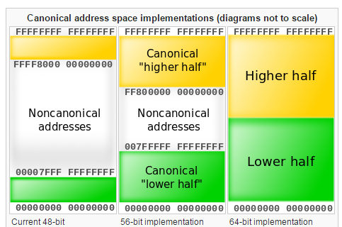
Virtual memory
https://en.wikipedia.org/wiki/X86-64

Slide 13
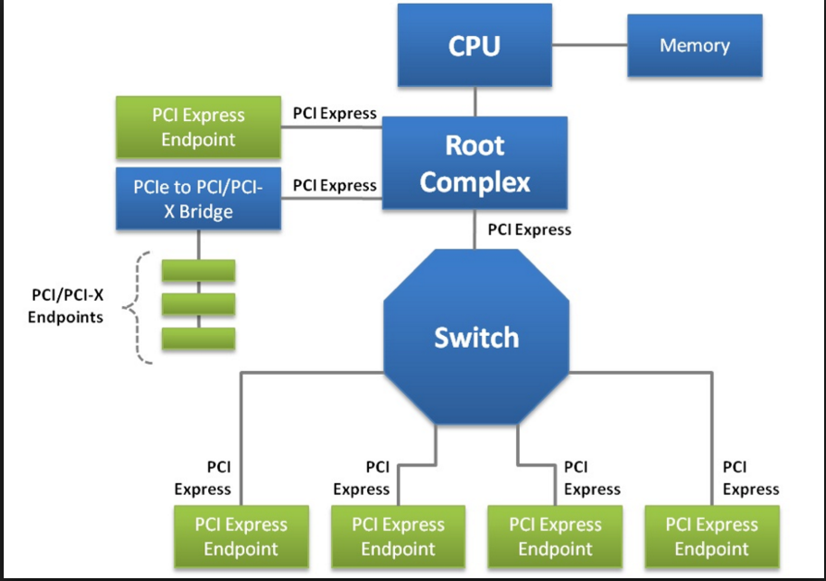
PCI & PCI-X & PCIe

Slide 14
PCI
Bus/ Device/Function
Legacy :Two 32-bit I/O locations are used, the first location (0xCF8) is named CONFIG_ADDRESS, and the second (0xCFC) is called CONFIG_DATA
BBBB BBBB DDDD DFFF OOOO OOOO
24 bits = ??? , 256 bytes of space configuration
BBBB BBBB DDDD DFFF OOOO OOOO OOOO
28 bits = ??? , 4096 bytes of space configuration
http://wiki.osdev.org/PCI

Slide 15
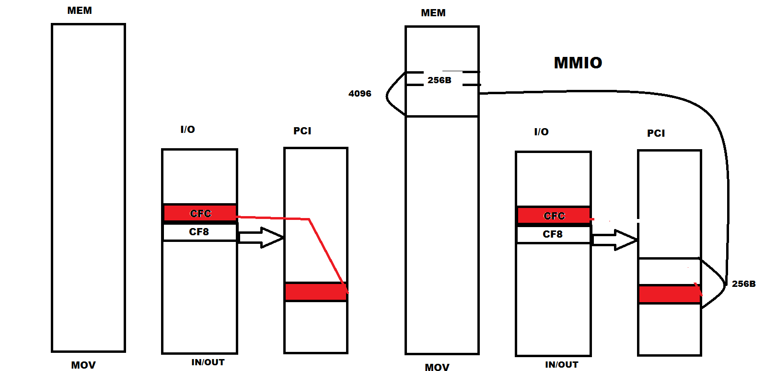
MMIO

